Slide 1
Soft Tissue Modelling for Orthopedic Surgery
K. Simmonds, F. Heimann, A. Contri, U. Schaarschmidt, V. Raveendran, S. Nepal, A. Massing, N. Avery ,
With assistance from problem setters B. Rasheed and H.G. Schaathun

Slide 2
Agenda
Introduction
Considerations
Topic three
Topic four
Topic five

Slide 3

Introduction Vision
Simulator training for surgeons is increasingly important. While simulators for basic skill training have already been deployed, they have insufficient fidelity to train experienced surgeons in particular and advanced procedures.

Slide 4
Introduction Problem
One of the problems to solve is dynamic modelling of soft tissue to allow simulation of deformation, tear, and cutting as will arise in surgical procedures.

Slide 5
Introduction Challenge
Soft-tissue deformation is readily simulated in mesh models, governed by differential equations which are solluble by finite element modelling.
However, tear (cutting) introduces discrete events, changing the topology of the mesh. This is known to be computationally hard.

Slide 6


Considerations and Assumptions
Subtitle

Slide 7
Chart

Slide 8
Table
 | Category 1 | Category 2 | Category 3 | Category 4
Item 1 | 4.5 | 2.3 | 1.7 | 5
Item 2 | 3.2 | 5.1 | 4.4 | 3
Item 3 | 2.1 | 1.7 | 2.5 | 2.8
Item 4 | 4.5 | 2.2 | 1.7 | 7

Slide 9

The way to get started is to quit talking and begin doing.
Walt Disney

Slide 10




Team
Name
Name
Name
Name
Title
Title
Title
Title

Slide 11
Timeline
Title
To start a presentation, go to the Slide Show tab, and select From Beginning.
Title
To display Presenter view, in Slide Show view, on the control bar at the bottom left select the three dots, and then Show Presenter View.
Title
During your presentation, the speaker notes are visible on your monitor, but aren't visible to the audience.
Title
Title
The Notes pane is a box that appears below each slide. Tap it to add notes.
If you don’t see the Notes pane or it is completely minimized, click Notes on the task bar across the bottom of the PowerPoint window.

Slide 12
Content
Subtitle
Subtitle
Add text, images, art, and videos.
Add transitions, animations, and motion.
Save to OneDrive, to get to your presentations from your computer, tablet, or phone.
Open the Design Ideas pane for instant slide makeovers.
When we have design ideas, we’ll show them to you right there.

Slide 13
Content
Subtitle
Subtitle
Subtitle
Add text, images, art, and videos.
Add transitions, animations, and motion.
Save to OneDrive, to get to your presentations from your computer, tablet, or phone.
Open the Design Ideas pane for instant slide makeovers.
When we have design ideas, we’ll show them to you right there.
This PowerPoint theme uses its own unique set of colors, fonts, and effects to create the overall look and feel of these slides.
PowerPoint has tons of themes to give your presentation just the right personality.

Slide 14

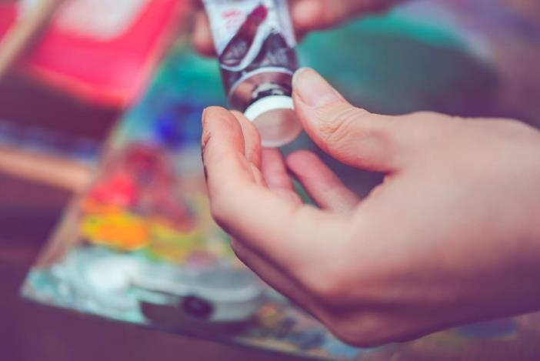
Summary
With PowerPoint, you can create presentations and share your work with others, wherever they are. Type the text you want here to get started. You can also add images, art, and videos on this template. Save to OneDrive and access your presentations from your computer, tablet, or phone.

Slide 15

Thank you
Presenter name
Email address
Website address

